Slide 1
Lecture 3: Regularization and Optimization

Slide 2
Outline
Regularization of NN
Norm Penalties
Early Stopping
Data Augmentation
Sparse Representation
Bagging
Dropout
Optimization
Challenges in Optimization
Momentum
Adaptive Learning Rate
Parameter Initialization
Batch Normalization

Slide 3
Outline
Regularization of NN
Norm Penalties
Early Stopping
Data Augmentation
Sparse Representation
Bagging
Dropout
Optimization
Challenges in Optimization
Momentum
Adaptive Learning Rate
Parameter Initialization
Batch Normalization

Slide 4
Regularization
Regularization is any modification we make to a learning algorithm that is intended to reduce its generalization error but not its training error.

Slide 5
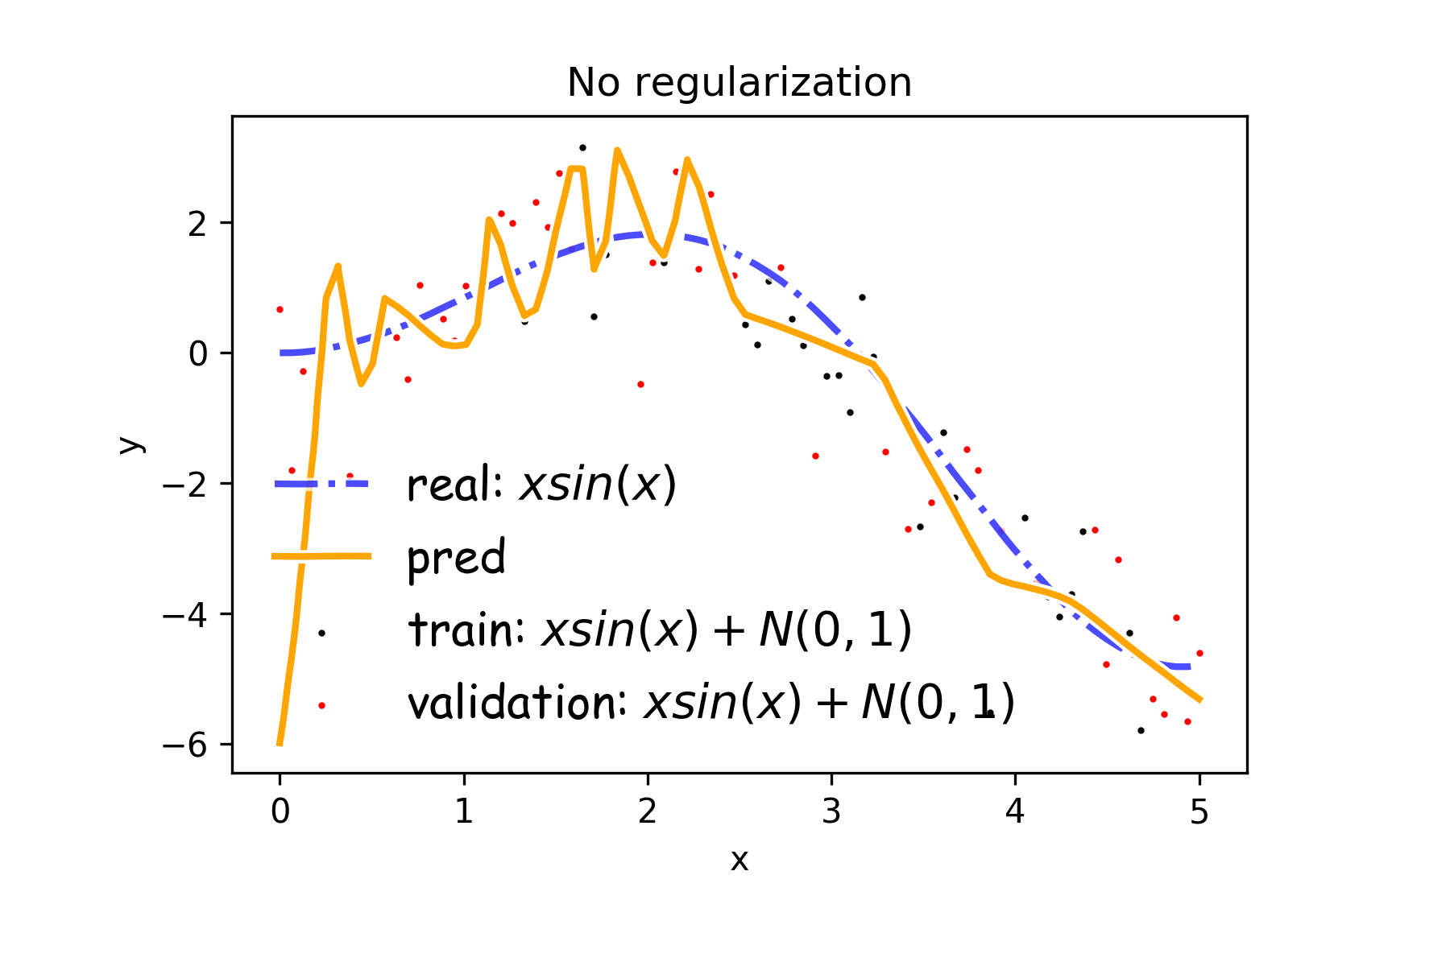
Overfitting
Fitting a deep neural network with 5 layers and 100 neurons per layer can lead to a very good prediction on the training set but poor prediction on validations set.

Slide 6
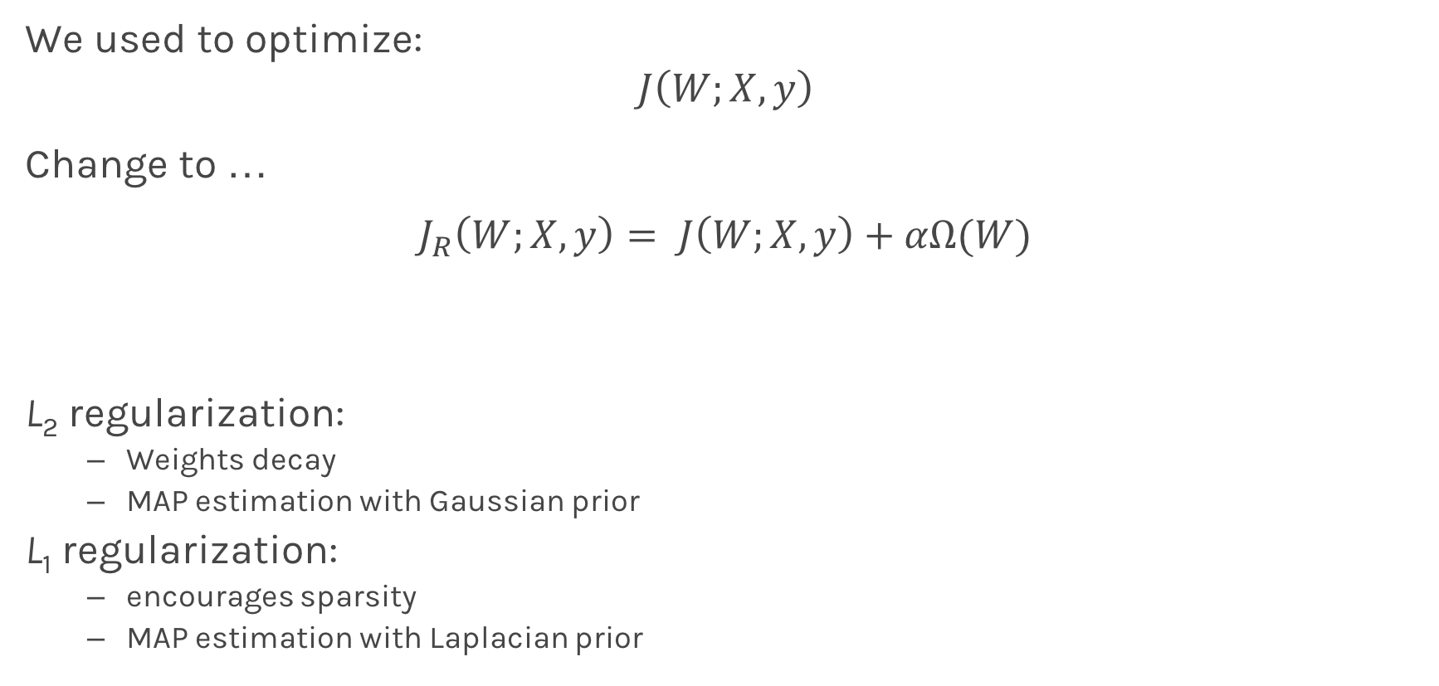
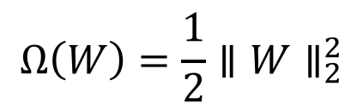
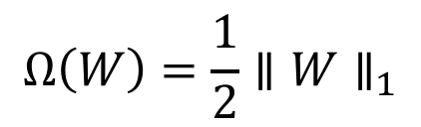
Norm Penalties
We used to optimize:
$$J\left(W;X, y\right)$$
Change to …
$$J_{R}\left(W;X,y\right)= J\left(W;X, y\right)+αΩ(W)$$
L₂ regularization:
Weights decay
MAP estimation with Gaussian prior
L₁ regularization:
encourages sparsity
MAP estimation with Laplacian prior
Biases not penalized
$$Ω\left(W\right)=\frac{1}{2}∥W∥_{2}^{2}$$
$$Ω\left(W\right)=\frac{1}{2}∥W∥_{1}$$

Slide 7
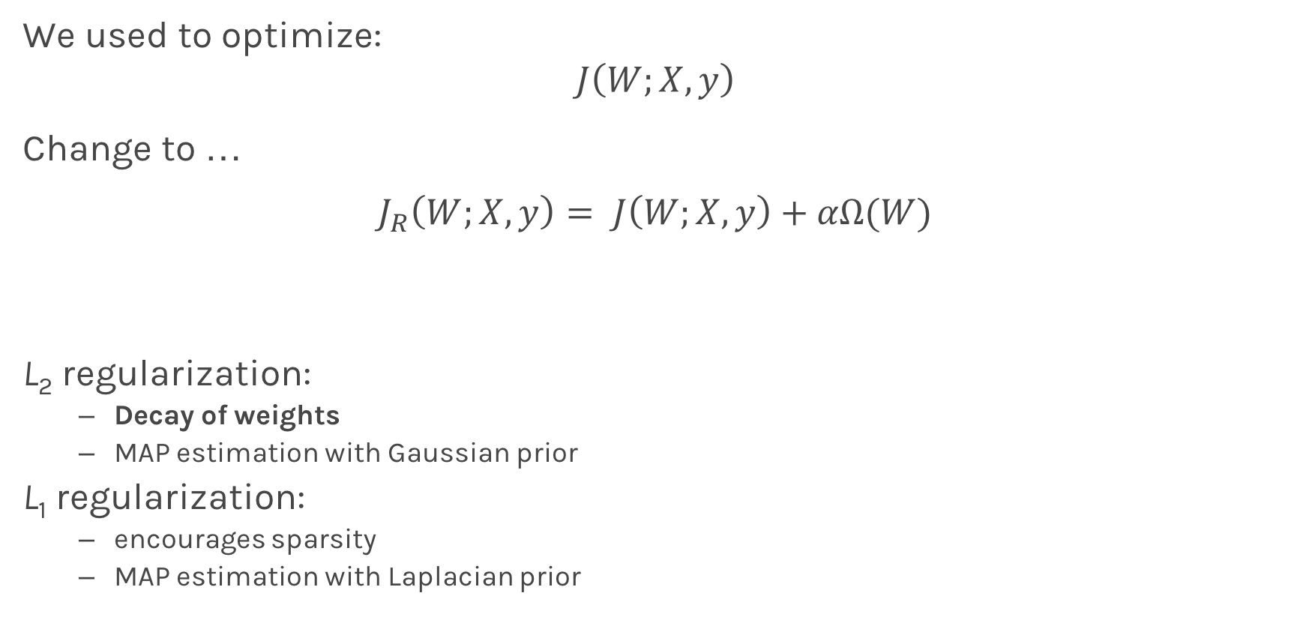
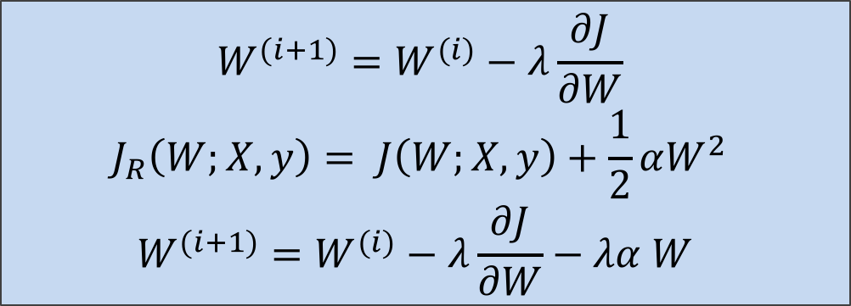
Norm Penalties
weights decay in proportion to its size.
We used to optimize:
$$J\left(W;X, y\right)$$
Change to …
$$J_{R}\left(W;X,y\right)= J\left(W;X, y\right)+αΩ(W)$$
L₂ regularization:
Decay of weights
MAP estimation with Gaussian prior
L₁ regularization:
encourages sparsity
MAP estimation with Laplacian prior
$$W^{(i+1)}=W^{(i)}−λ\frac{∂J}{∂W} \\ J_{R}\left(W;X,y\right)= J\left(W;X, y\right)+\frac{1}{2}αW^{2} \\ W^{(i+1)}=W^{(i)}−λ\frac{∂J}{∂W}−λα W$$
Biases not penalized
$$Ω\left(W\right)=\frac{1}{2}∥W∥_{2}^{2}$$
$$Ω\left(W\right)=\frac{1}{2}∥W∥_{1}$$

Slide 8
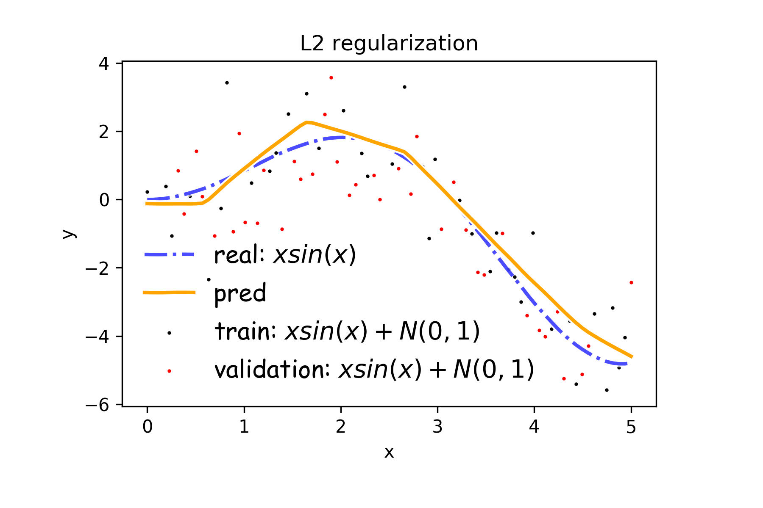
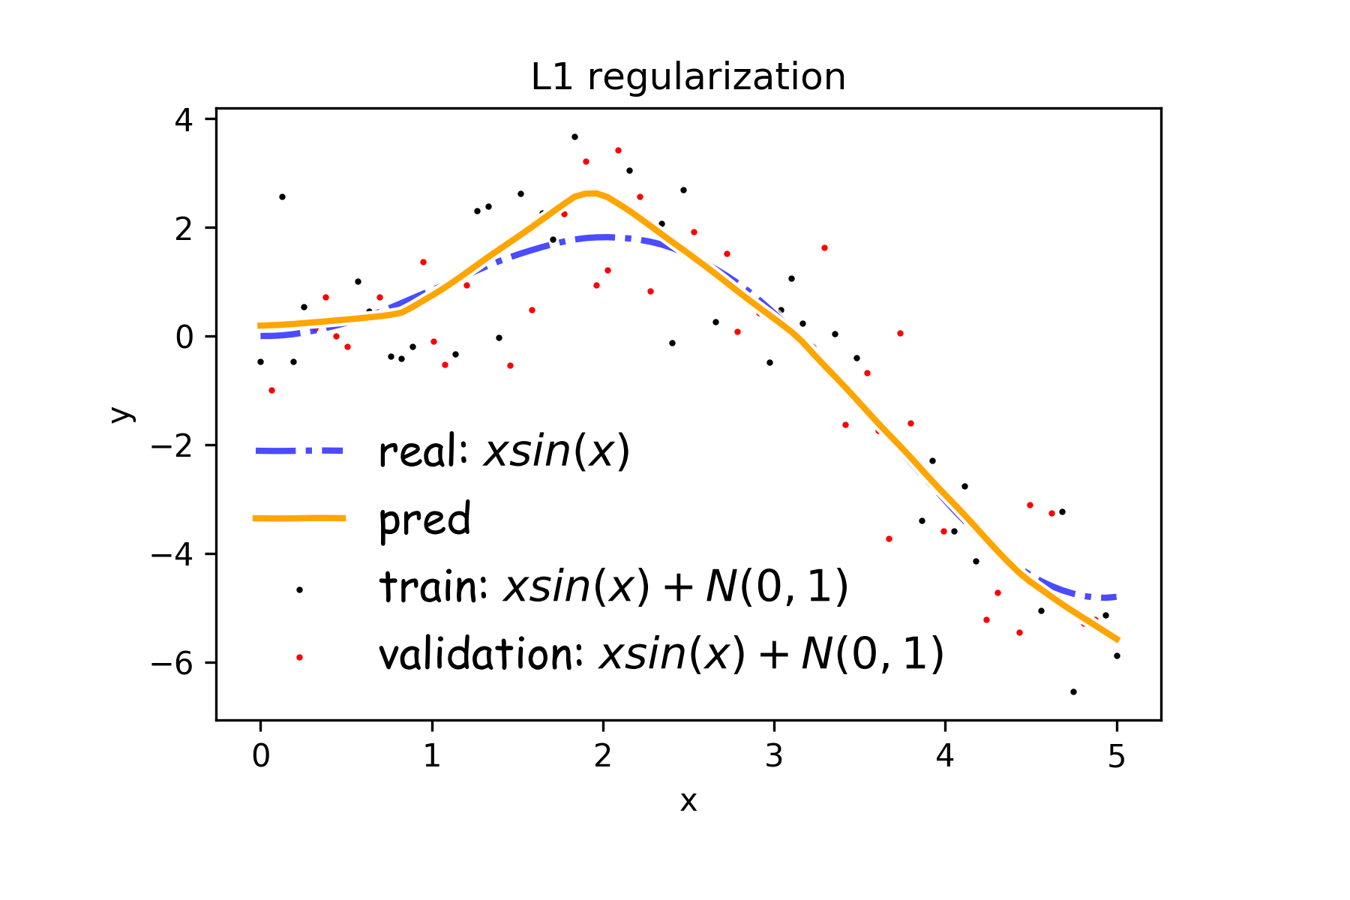
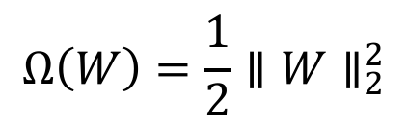
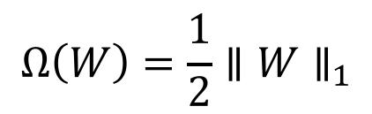
Norm Penalties
$$Ω\left(W\right)=\frac{1}{2}∥W∥_{2}^{2}$$
$$Ω\left(W\right)=\frac{1}{2}∥W∥_{1}$$

Slide 9
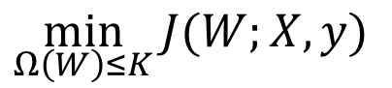
Norm Penalties as Constraints
$$\min_{Ω\left(W\right)≤K}{J(W;X,y)}$$
Useful if K is known in advance
Optimization:
Construct Lagrangian and apply gradient descent
Projected gradient descent

Slide 10
Outline
Regularization of NN
Norm Penalties
Early Stopping
Data Augmentation
Sparse Representation
Bagging
Dropout
Optimization
Challenges in Optimization
Momentum
Adaptive Learning Rate
Parameter Initialization
Batch Normalization

Slide 11
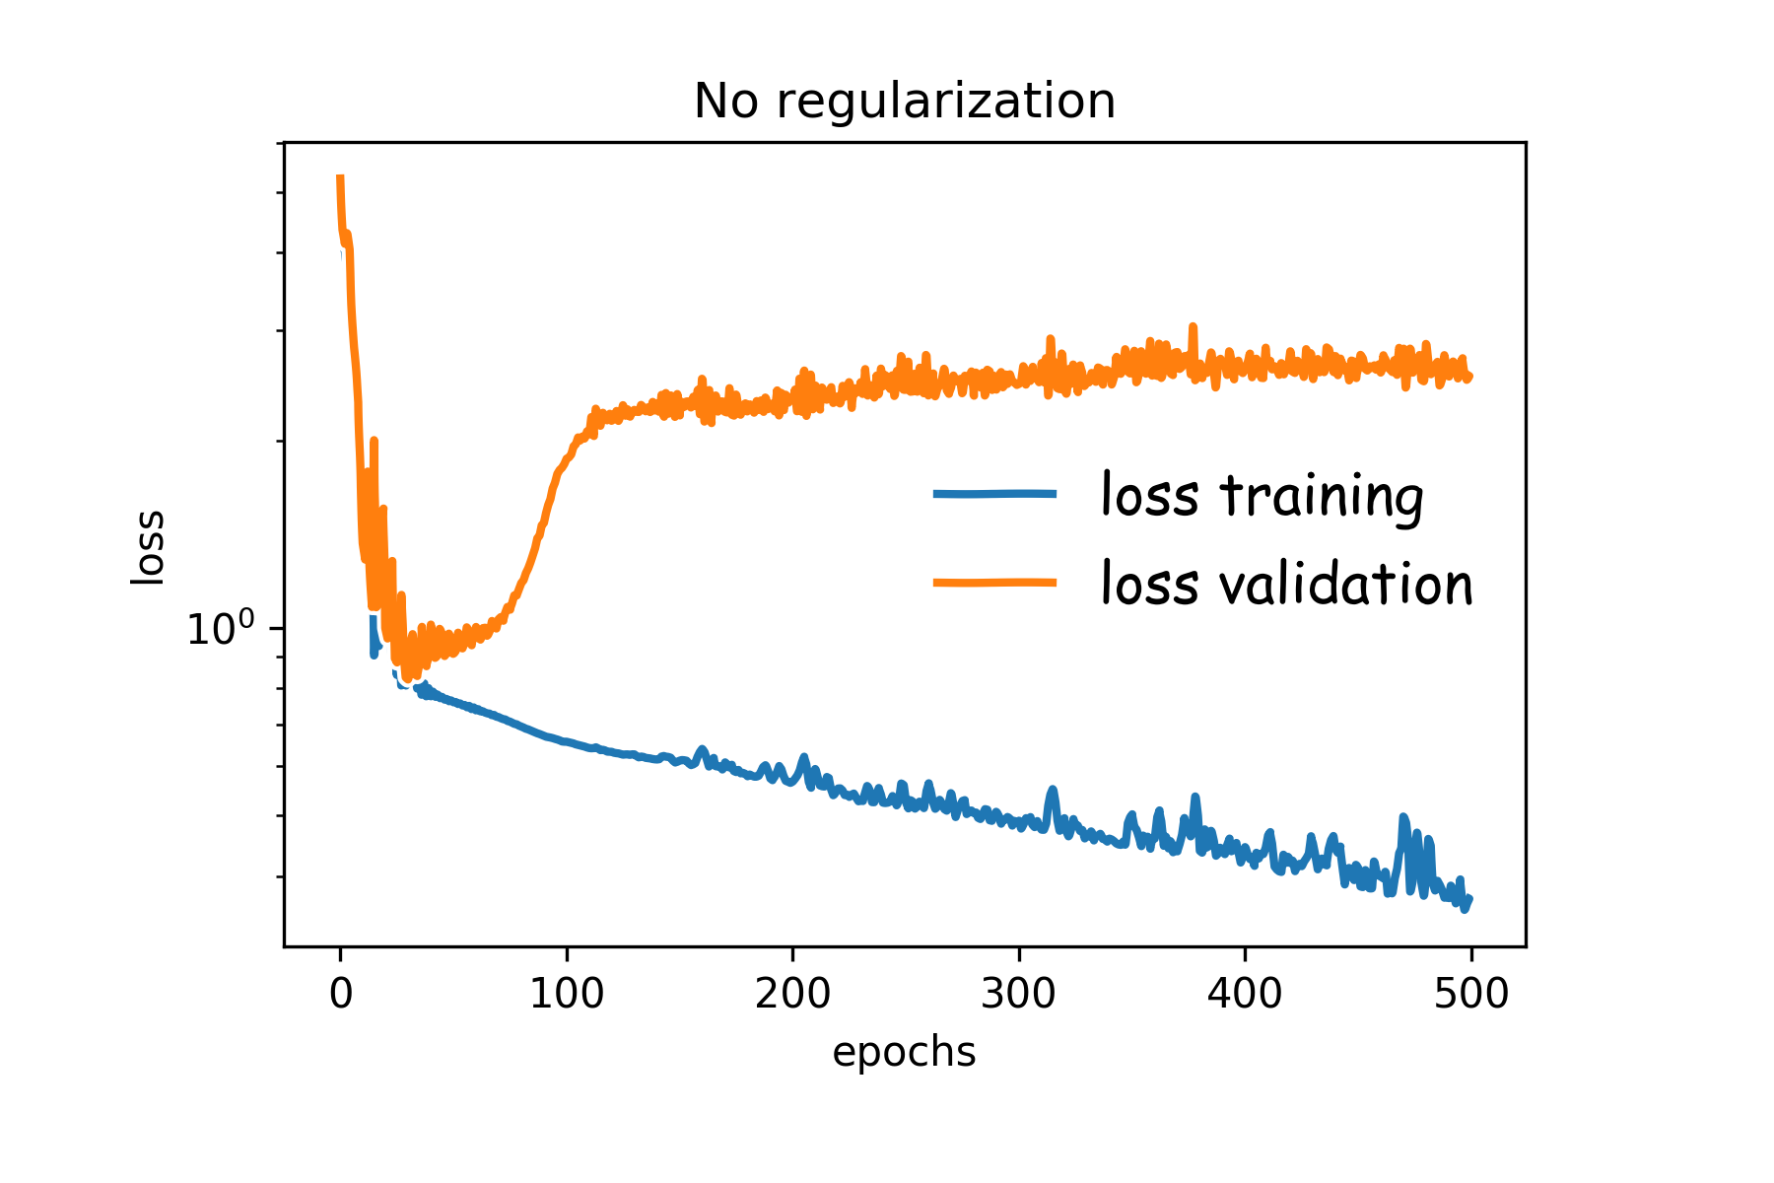
Early Stopping
Early stopping: terminate while validation set performance is better
Training time can be treated as a hyperparameter

Slide 12
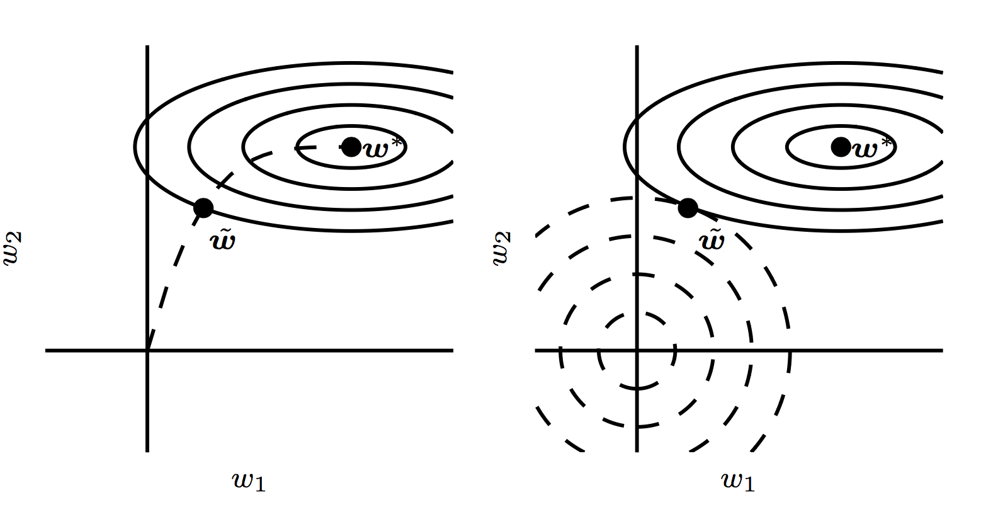
Early Stopping

Slide 13
Outline
Regularization of NN
Norm Penalties
Early Stopping
Data Augmentation
Sparse Representation
Bagging
Dropout
Optimization
Challenges in Optimization
Momentum
Adaptive Learning Rate
Parameter Initialization
Batch Normalization

Slide 14
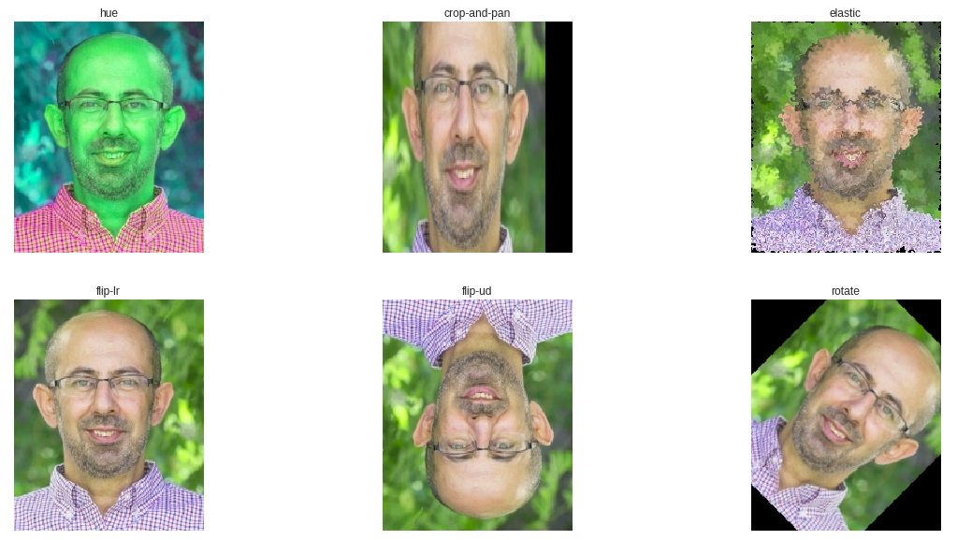
Data Augmentation

Slide 15
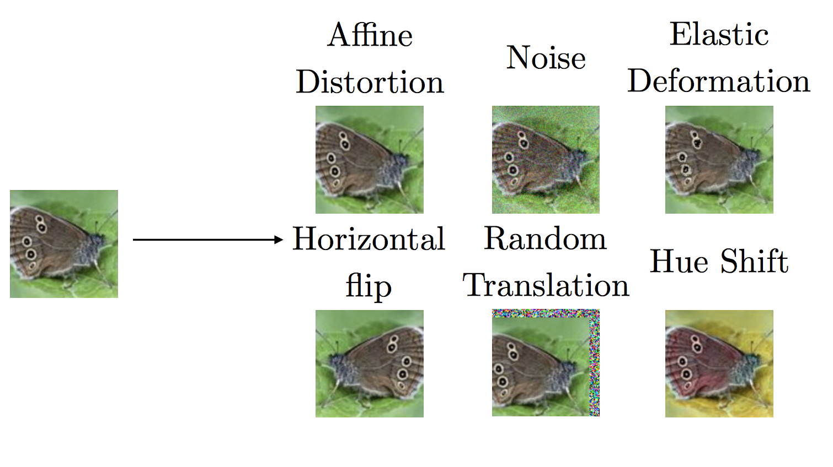
Data Augmentation

Slide 16
Outline
Regularization of NN
Norm Penalties
Early Stopping
Data Augmentation
Sparse Representation
Bagging
Dropout
Optimization
Challenges in Optimization
Momentum
Adaptive Learning Rate
Parameter Initialization
Batch Normalization

Slide 17
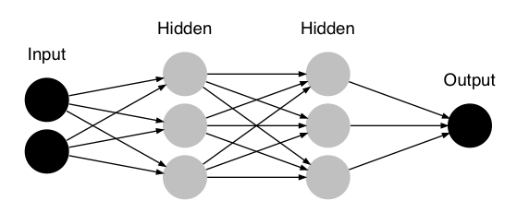

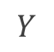
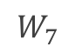
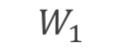
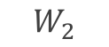
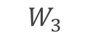
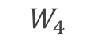
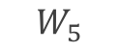
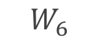
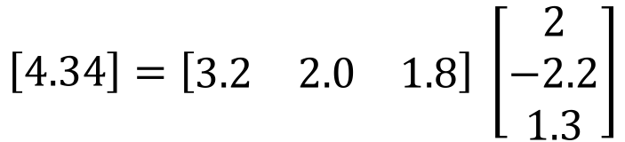
Sparse Representation
$$W_{1}$$
$$W_{4}$$
$$W_{2}$$
$$W_{5}$$
$$W_{7}$$
$$Y$$
$$W_{3}$$
$$W_{6}$$
$$J\left(θ;X, y\right)$$
$$\left[4.34\right]=\left[\begin{matrix}3.2 & 2.0 & 1.8\end{matrix}\right] \left[\begin{aligned}2 \\ −2.2 \\ 1.3\end{aligned}\right]$$
$$W_{7}$$

Slide 18
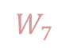
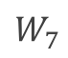
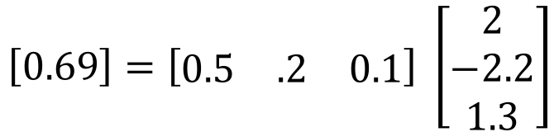
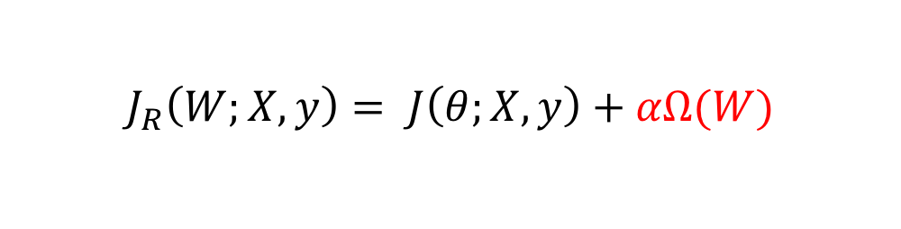
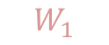
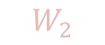
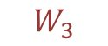
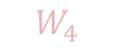
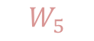
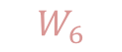
Sparse Representation
$$W_{1}$$
$$W_{4}$$
$$W_{2}$$
$$W_{5}$$
$$W_{7}$$
$$Y$$
$$W_{3}$$
$$W_{6}$$
$$J_{R}\left(W;X,y\right)= J\left(θ;X, y\right)+αΩ(W)$$
$$\left[0.69\right]=\left[\begin{matrix}0.5 & .2 & 0.1\end{matrix}\right] \left[\begin{aligned}2 \\ −2.2 \\ 1.3\end{aligned}\right]$$
$$W_{7}$$
Weights in output layer

Slide 19
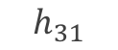
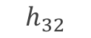
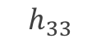
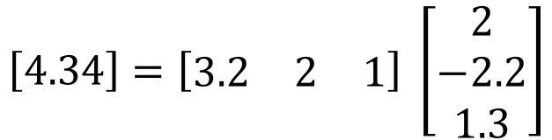
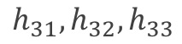
Sparse Representation
$$h_{31}$$
$$h_{32}$$
$$W_{7}$$
$$Y$$
$$h_{33}$$
$$J\left(θ;X, y\right)$$
$$\left[4.34\right]=\left[\begin{matrix}3.2 & 2 & 1\end{matrix}\right] \left[\begin{aligned}2 \\ −2.2 \\ 1.3\end{aligned}\right]$$
$$h_{31},h_{32},h_{33}$$

Slide 20
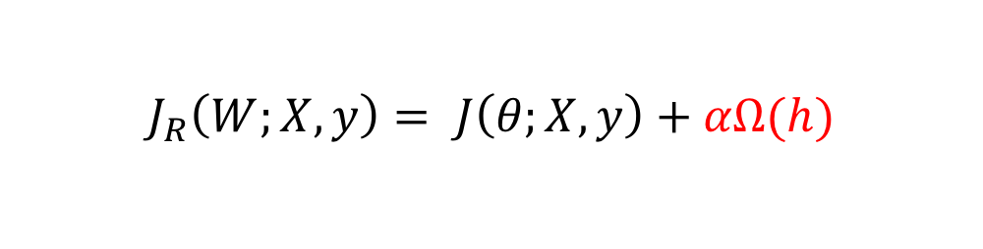
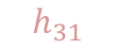
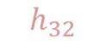
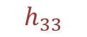
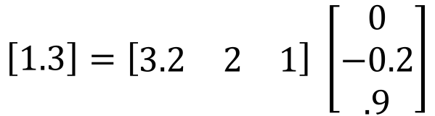
Sparse Representation
$$h_{31}$$
$$h_{32}$$
$$h_{33}$$
$$J_{R}\left(W;X,y\right)= J\left(θ;X, y\right)+αΩ(h)$$
$$\left[1.3\right]=\left[\begin{matrix}3.2 & 2 & 1\end{matrix}\right] \left[\begin{aligned}0 \\ −0.2 \\ .9\end{aligned}\right]$$
$$h_{31},h_{32},h_{33}$$
Output of hidden layer

Slide 21
Outline
Regularization of NN
Norm Penalties
Early Stopping
Data Augmentation
Sparse Representation
Bagging
Dropout
Optimization
Challenges in Optimization
Momentum
Adaptive Learning Rate
Parameter Initialization
Batch Normalization

Slide 22

Noise Robustness
Random perturbation of network weights
Gaussian noise: Equivalent to minimizing loss with regularization term
Encourages smooth function: small perturbation in weights leads to small changes in output
Injecting noise in output labels
Better convergence: prevents pursuit of hard probabilities
$$𝔼[∥∇_{W}y\left(x\right)∥]$$

Slide 23
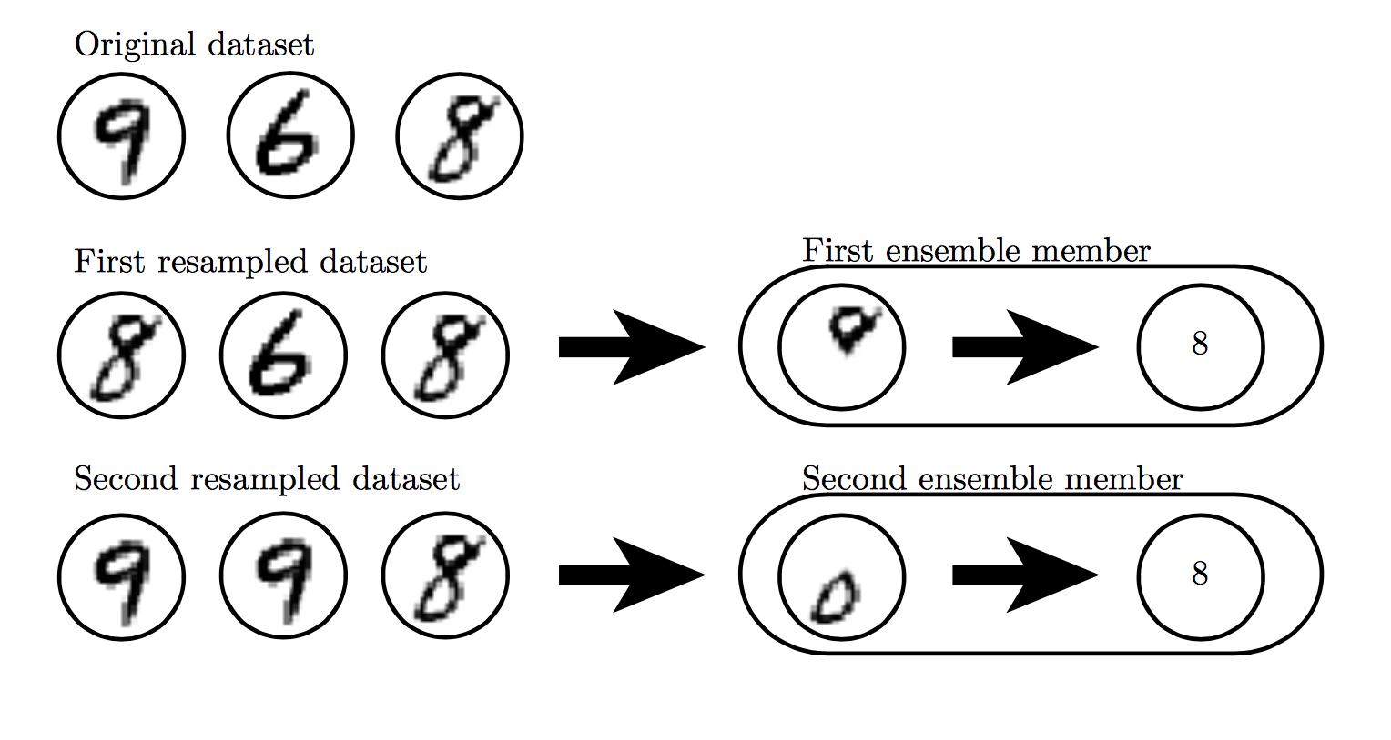

Slide 24
Outline
Regularization of NN
Norm Penalties
Early Stopping
Data Augmentation
Sparse Representation
Bagging
Dropout
Optimization
Challenges in Optimization
Momentum
Adaptive Learning Rate
Parameter Initialization
Batch Normalization

Slide 25
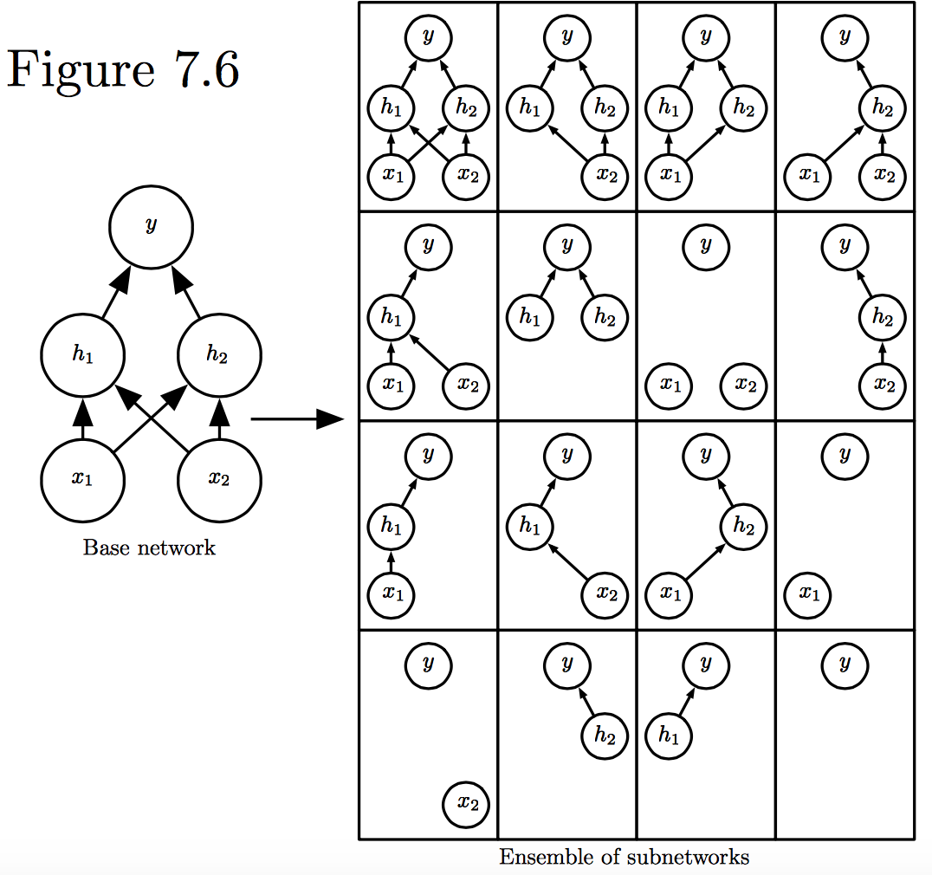
Dropout
Train all sub-networks obtained by removing non-output units from base network

Slide 26
Dropout: Stochastic GD
For each new example/mini-batch:
Randomly sample a binary mask μ independently, where μ_{i} indicates if input/hidden node i is included
Multiply output of node i with μ_{i}, and perform gradient update
Typically, an input node is included with prob=0.8, hidden node with prob=0.5.

Slide 27
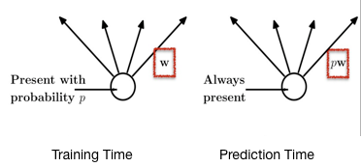
Dropout: Weight Scaling
During prediction time use all units, but scale weights with probability of inclusion
Notes:
https://chatbotslife.com/regularization-in-deep-learning-f649a45d6e0

Slide 28
Adversarial Examples

Slide 29


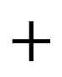
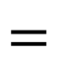
Adversarial Examples
$$+$$
$$=$$
Panda 57% confidence
noise
Gibbon 99.3% confidence
Training on adversarial examples is mostly intended to improve security, but can sometimes provide generic regularization.

Slide 30
Outline
Regularization of NN
Norm Penalties
Early Stopping
Data Augmentation
Sparse Representation
Bagging
Dropout
Optimization
Challenges in Optimization
Momentum
Adaptive Learning Rate
Parameter Initialization
Batch Normalization

Slide 31
Optimization

Slide 32
Learning vs. Optimization
Goal of learning: minimize generalization error
In practice, empirical risk minimization:
Quantity optimized different from the quantity we care about

Slide 33
Batch vs. Stochastic Algorithms
Batch algorithms
Optimize empirical risk using exact gradients
Stochastic algorithms
Estimates gradient from a small random sample
Large mini-batch: gradient computation expensive
Small mini-batch: greater variance in estimate, longer steps for convergence

Slide 34

Critical Points
Points with zero gradient
2nd-derivate (Hessian) determines curvature
Goodfellow et al. (2016)

Slide 35
Stochastic Gradient Descent
Take small steps in direction of negative gradient
Sample m examples from training set and compute:
Update parameters:
In practice: shuffle training set once and pass through multiple times

Slide 36

Stochastic Gradient Descent
Oscillations because updates do not exploit curvature information
Goodfellow et al. (2016)

Slide 37
Outline
Regularization of NN
Norm Penalties
Early Stopping
Data Augmentation
Bagging
Dropout
Optimization
Challenges in Optimization
Momentum
Adaptive Learning Rate
Parameter Initialization
Batch Normalization

Slide 38

Local Minima
Goodfellow et al. (2016)

Slide 39
Local Minima
Old view: local minima is major problem in neural network training
Recent view:
For sufficiently large neural networks, most local minima incur low cost
Not important to find true global minimum

Slide 40

Saddle Points
Both local min and max
Recent studies indicate that in high dim, saddle points are more likely than local min
Gradient can be very small near saddle points
Goodfellow et al. (2016)

Slide 41

Saddle Points
SGD is seen to escape saddle points
Moves down-hill, uses noisy gradients
Second-order methods get stuck
solves for a point with zero gradient
Goodfellow et al. (2016)

Slide 42

Poor Conditioning
Poorly conditioned Hessian matrix
High curvature: small steps leads to huge increase
Learning is slow despite strong gradients
Oscillations slow down progress

Slide 43

No Critical Points
Some cost functions do not have critical points. In particular classification.

Slide 44

No Critical Points
Gradient norm increases, but validation error decreases
Convolution Nets for Object Detection
Goodfellow et al. (2016)

Slide 45

Exploding and Vanishing Gradients
Linear activation
deeplearning.ai

Slide 46
Exploding and Vanishing Gradients

Slide 47
Exploding and Vanishing Gradients
Explodes!
Vanishes!

Slide 48

Exploding and Vanishing Gradients
Exploding gradients lead to cliffs
Can be mitigated using gradient clipping
Goodfellow et al. (2016)

Slide 49
Outline
Regularization of NN
Norm Penalties
Early Stopping
Data Augmentation
Bagging
Dropout
Optimization
Challenges in Optimization
Momentum
Adaptive Learning Rate
Parameter Initialization
Batch Normalization

Slide 50
Momentum
SGD is slow when there is high curvature
Average gradient presents faster path to opt:
vertical components cancel out
Notes:
https://distill.pub/2017/momentum/

Slide 51
Momentum
Uses past gradients for update
Maintains a new quantity: ‘velocity’
Exponentially decaying average of gradients:
Current gradient update
controls how quickly effect of past gradients decay

Slide 52
Momentum
Compute gradient estimate:
Update velocity:
Update parameters:

Slide 53

Momentum
Damped oscillations:
gradients in opposite directions get cancelled out
Goodfellow et al. (2016)

Slide 54
Nesterov Momentum
Apply an interim update:
Perform a correction based on gradient at the interim point:
Momentum based on look-ahead slope

Slide 55
Outline
Regularization of NN
Norm Penalties
Early Stopping
Data Augmentation
Bagging
Dropout
Optimization
Challenges in Optimization
Momentum
Adaptive Learning Rate
Parameter Initialization
Batch Normalization

Slide 56
Adaptive Learning Rates
Slow
Fast
Oscillations along vertical direction
Learning must be slower along parameter 2
Use a different learning rate for each parameter?

Slide 57
AdaGrad
Accumulate squared gradients:
Update each parameter:
Greater progress along gently sloped directions
Inversely proportional to cumulative squared gradient

Slide 58
RMSProp
For non-convex problems, AdaGrad can prematurely decrease learning rate
Use exponentially weighted average for gradient accumulation

Slide 59
Adam
RMSProp + Momentum
Estimate first moment:
Estimate second moment:
Update parameters:
Also applies bias correction to v and r
Works well in practice, is fairly robust to hyper-parameters

Slide 60
Outline
Regularization of NN
Norm Penalties
Early Stopping
Data Augmentation
Bagging
Dropout
Optimization
Challenges in Optimization
Momentum
Adaptive Learning Rate
Parameter Initialization
Batch Normalization

Slide 61
Parameter Initialization
Goal: break symmetry between units
so that each unit computes a different function
Initialize all weights (not biases) randomly
Gaussian or uniform distribution
Scale of initialization?
Large -> grad explosion, Small -> grad vanishing

Slide 62
Xavier Initialization
Heuristic for all outputs to have unit variance
For a fully-connected layer with m inputs:
For ReLU units, it is recommended:

Slide 63
Normalized Initialization
Fully-connected layer with m inputs, n outputs:
Heuristic trades off between initialize all layers have same activation and gradient variance
Sparse variant when m is large
Initialize k nonzero weights in each unit

Slide 64
Bias Initialization
Output unit bias
Marginal statistics of the output in the training set
Hidden unit bias
Avoid saturation at initialization
E.g. in ReLU, initialize bias to 0.1 instead of 0
Units controlling participation of other units
Set bias to allow participation at initialization

Slide 65
Outline
Challenges in Optimization
Momentum
Adaptive Learning Rate
Parameter Initialization
Batch Normalization

Slide 66
Feature Normalization
Good practice to normalize features before applying learning algorithm:
Features in same scale: mean 0 and variance 1
Speeds up learning
Feature vector
Vector of mean feature values
Vector of SD of feature values

Slide 67
Feature Normalization
Before normalization
After normalization

Slide 68

Internal Covariance Shift
Each hidden layer changes distribution of inputs to next layer: slows down learning
…
Normalize inputs to layer 2
Normalize inputs to layer n

Slide 69
Batch Normalization
Training time:
Mini-batch of activations for layer to normalize
K hidden layer activations
N data points in mini-batch

Slide 70
Batch Normalization
Training time:
Mini-batch of activations for layer to normalize
where
Vector of mean activations across mini-batch
Vector of SD of each unit across mini-batch

Slide 71
Batch Normalization
Training time:
Normalization can reduce expressive power
Instead use:
Allows network to control range of normalization
Learnable parameters

Slide 72
Batch Normalization
Batch 1
…..
Add normalization operations for layer 1
Batch N

Slide 73
Batch Normalization
Batch 1
…..
Add normalization operations for layer 2 and so on …
Batch N

Slide 74
Batch Normalization
Differentiate the joint loss for N mini-batches
Back-propagate through the norm operations
Test time:
Model needs to be evaluated on a single example
Replace μ and σ with running averages collected during training

